Slide 2

Analyzing Prospect Management Using Projected WAR
Mex Tables
What We Want to Achieve
Prospect Classification
Creating the Table
Scaling the Table
Scaled Tables by Year
WAR Ranking by Org
How Prospect Management Impacts Big League Success

Slide 3

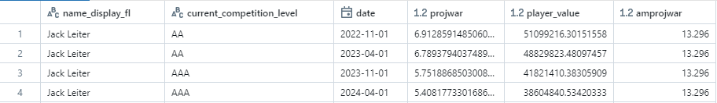
(1) Mex Tables
What are they?
The Hitters Mex and Pitchers Mex tables contain projections for prospects around the league, calculated via the Mex model
Values in the table include a prospect’s projected WAR and player (asset) value, as well as amateur values from the amateur model
Opted to use projected WAR for this analysis

Slide 4
(2) What We Want to Achieve
Questions
How are organizations adding/losing overall value in the way they draft, develop, and handle prospects?
Which teams have found consistent success in one (or multiple) areas across 2022-2024?
How do the Rangers stack up against the competition?
Plan
We’ll look at projected WAR from six mex model runs from 2022-2024 – one at the start and end of each year – and classify each prospect into a specific subgroup to find how each org is changing their overall WAR by year

Slide 5
(3) Prospect Classification
Prospect Subgroups
Full Year | Player was in both runs on the year and stayed with the focus organization
Traded | Player was in both runs but was with the focus organization to start and a different org to end
Acquired | Player was in both runs but was with a different organization to start and the focus org to end
Called Up | Player was only in the START run but graduated out of the mex model due to >100 days of big league service
Released | Player was only in the START run but did not appear in the end run for any organization
Drafted | Player was only in the END run because they were drafted that year
Late Bloomers | Player was only in the END run but they were with the focus organization at the start of the year

Slide 6
(4) Creating the Table
Initial Table
The first table used the raw projected WAR values for each player
Found differences from start to end value for each player
Aggregated by organization and subgroup to find overall change

Slide 7

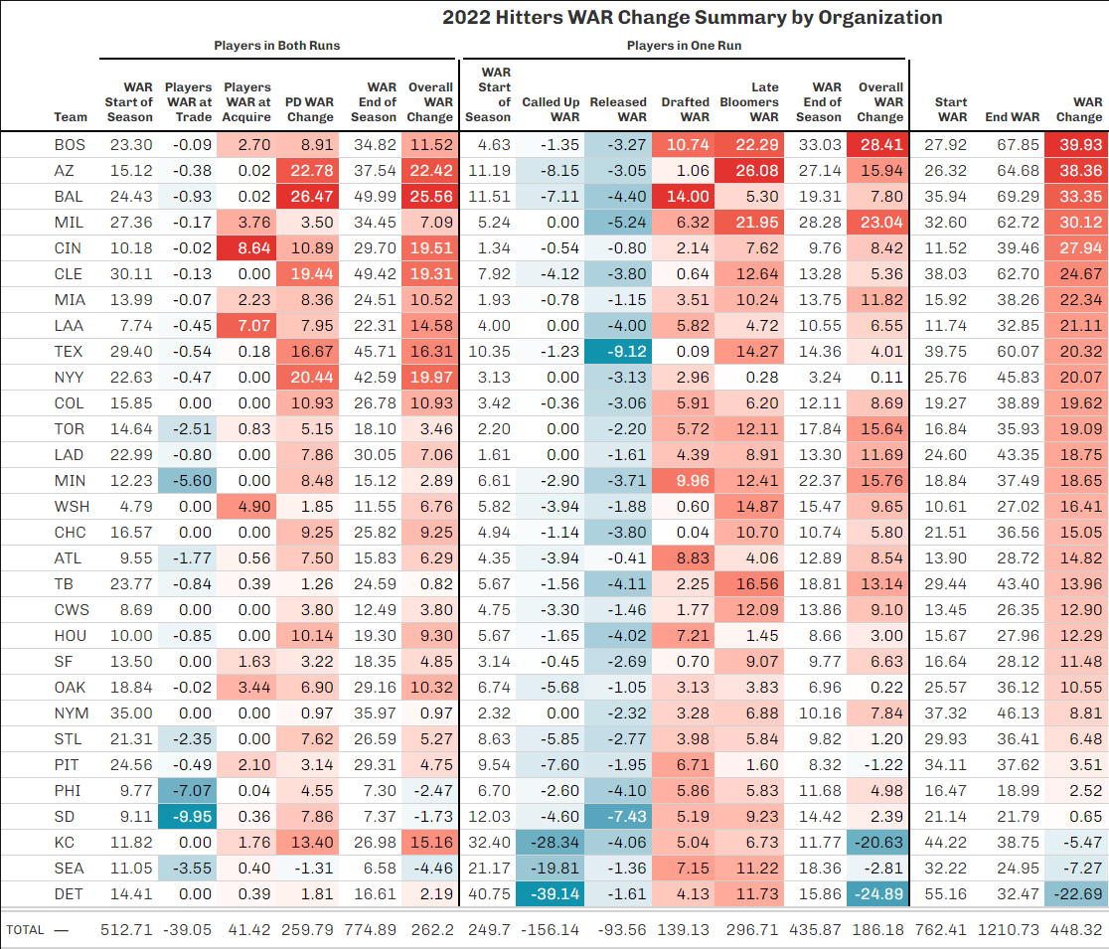
2022 Hitters Table
“PD WAR Change” is a combination of Full Year change, Pre-Trade change, and Post-Acquire change
Broken into two sections: Players in Both Runs and Players in One Run
Notice anything weird about the table?

Slide 8
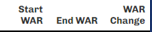
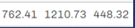
2022 Hitters Table
“PD WAR Change” is a combination of Full Year change, Pre-Trade change, and Post-Acquire change
Broken into two sections: Players in Both Runs and Players in One Run
Notice anything weird about the table?
There is not a net zero WAR change for the whole system!
Would expect it to net close to zero (Call Ups/Releases ≈ Drafts)

Slide 9
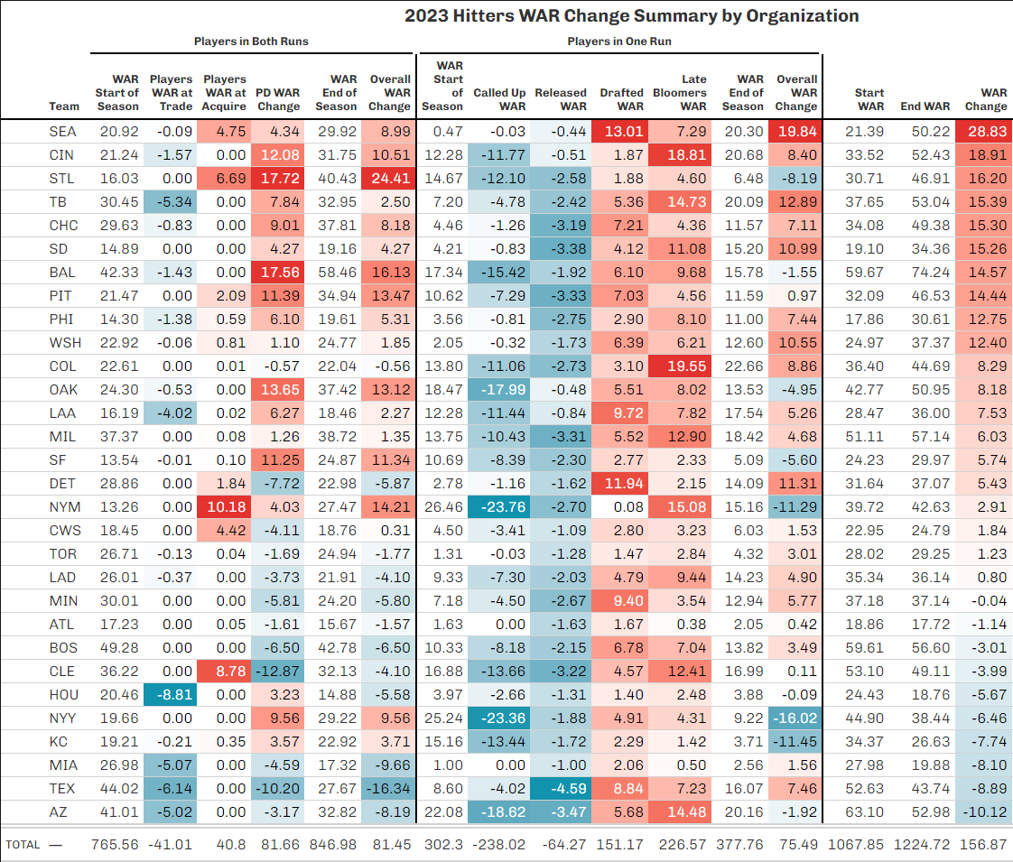
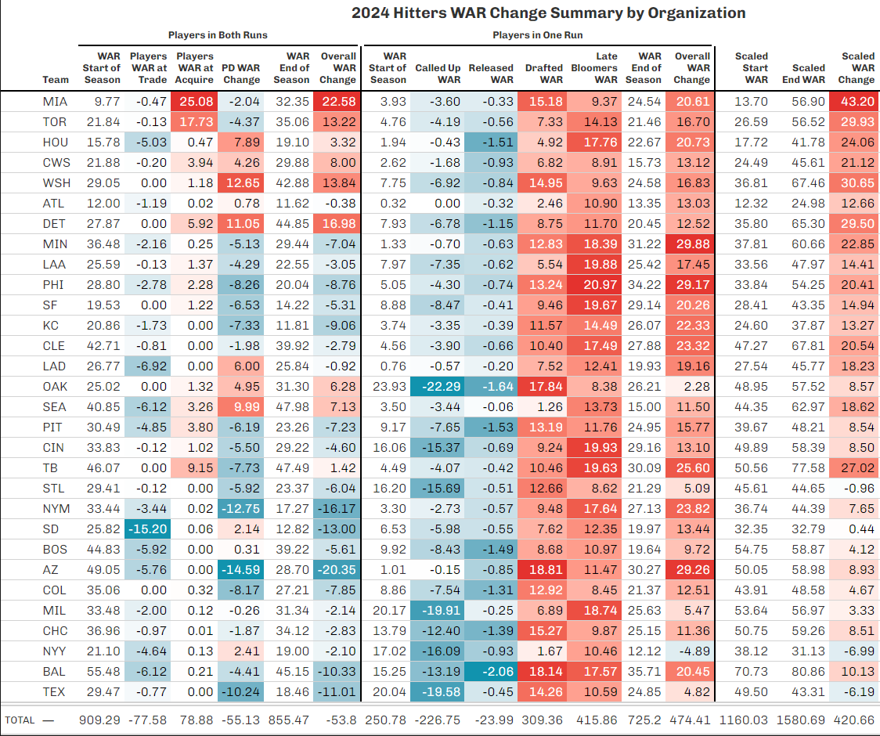
Same with 2023 and 2024 Hitters
* Pitchers faced the same issue. How do we fix this?

Slide 10

(5) Scaling the Table
How To Solve This Issue
To resolve the non-zero net WAR change, we scale each run to a common value
Steps:
Find average WAR/player across the six runs
0.5 for hitters, 0.29 for pitchers
Multiply this average by the # of rows in a run to get the “expected overall WAR”
Take the proportion of the “expected overall WAR” to the “true overall WAR” as the scaling constant
Multiply each value in a run by this constant to scale to a common value
$$\frac{expWAR}{trueWAR}=Scaling Constant$$

Slide 11
Example with 2022 Hitters
4/1/2022 Run –
True WAR: 765.6
# Players: 2379
Expected WAR: 2379 * 0.5 = 1189.5
Scaling Constant = 1189.5/765.6 = 1.55
11/1/2022 Run –
True WAR: 1211.4
# Players: 1873
Expected WAR: 1873 * 0.5 = 936.5
Scaling Constant = 936.5/1211.4 = 0.77

Slide 12
How will this affect individual players?
When the scaling constants are as extreme as in 2022, the new scaled values for individual players can misrepresent their true WAR change across the course of a year.
E.g. Evan Carter in 2022
Carter truly improved by 2.3 projected WAR in 2022, but after scaling, it shows he LOST 2.2 WAR. What gives?
 | Start WAR | End WAR | WAR Change
True | 5.05 | 7.34 | +2.29
Constant | x 1.55 | x 0.77
Scaled | 7.83 | 5.65 | -2.18

Slide 13


The Key Factor
To understand the breakdowns of individual players on the following slides, the following must be understood about the individual player WARs after scaling:
“THE WAR VALUE FOR EACH PLAYER DOES NOT REPRESENT THEIR TRUE WAR, BUT RATHER THE PROPORTION OF WAR THEY CONTRIBUTE TO THE SYSTEM AS A WHOLE.”
If a full year player loses WAR, it is because their piece of the pie got smaller from start to end, not because they got worse (As was the case with Evan Carter).
Start
End
$$\frac{5.05}{765.6}=0.66\%$$
$$\frac{7.34}{1211.4}=0.61\%$$

Slide 14
(6) Scaled Tables By Year
Summary
The following slides contain the hitters and pitchers WAR tables for 2022, 2023, and 2024
The teams will be ranked by WAR Change/Player rather than overall WAR change
Since all tables on the same scale and differing # of players in each run
Breakdowns of the top, bottom, and most extreme teams based on the primary contributors to their gains/losses are included
Breakdowns for the Rangers in each year will be covered as well

Slide 15
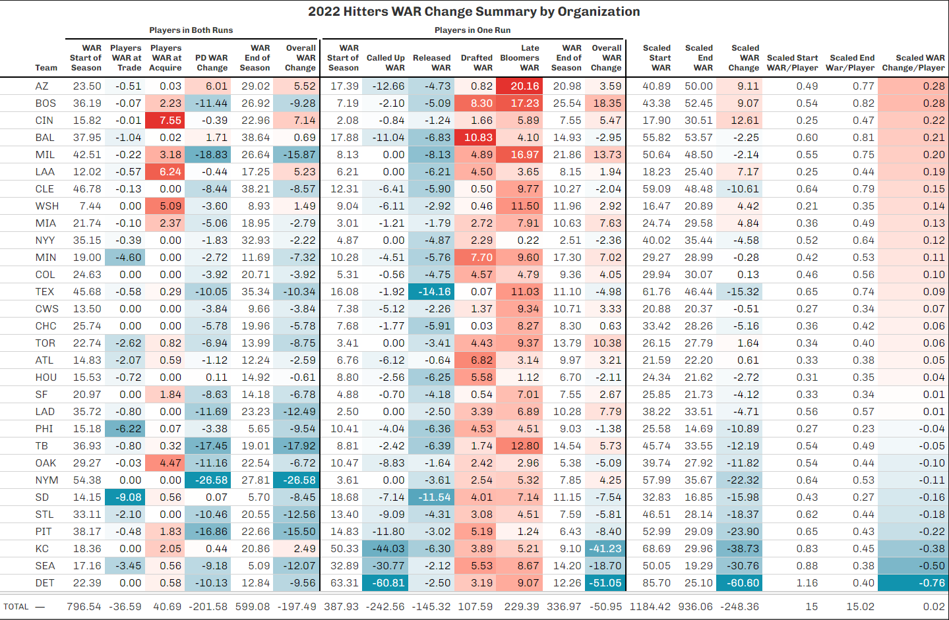
2022 Hitters
#13
Net change close to zero

Slide 16
2022 Hitters
Top Team: AZ
Biggest positive contributor(s) in both runs –
PD WAR Change (+6.01)
Primary cause(s) – Corbin Carroll (+9.9)
Biggest positive contributor(s) in one run –
Late Bloomers WAR Change (+20.16)
Primary cause(s) – Jordan Lawlar (+15.04)
Bottom Team: DET
Biggest negative contributor(s) in both runs –
PD WAR Change (-10.13)
Primary cause(s) – JD McLaughlin (-2.22), Ryan Kreidler (-1.89), Daniel Cabrera (-1.35)
Biggest negative contributor(s) in one run –
Called Up WAR Change (-60.81)
Primary cause(s) – Spencer Torkelson (-29.74), Riley Greene (-29.53)

Slide 17
2022 Hitters
Extremes:
Most extreme trade change: SD (-9.08)
Primary cause(s) – Robert Hassell (-4.76), Esteury Ruiz (-2.66)
Most extreme acquire change: CIN (+7.55)
Primary cause(s) – Noelvi Marte (+3.05), Spencer Steer (+2.73), Christian Encarnacion-Strand (+1.78)
Most extreme PD change: NYM (-26.58)
Primary cause(s) – Francisco Alvarez (-15.78), Khalil Lee (-4.32)
Most extreme called up change: DET (-60.81)
Most extreme drafted change: BAL (+10.83)
Jackson Holliday (+4.32), Dylan Beavers (+2.24), Max Wagner (+1.92)
Most extreme late bloomers change: AZ (+20.16)
Most extreme released change: TEX (-14.16)

Slide 18
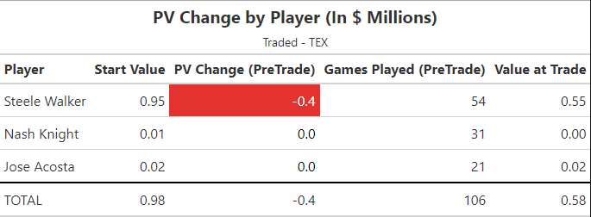
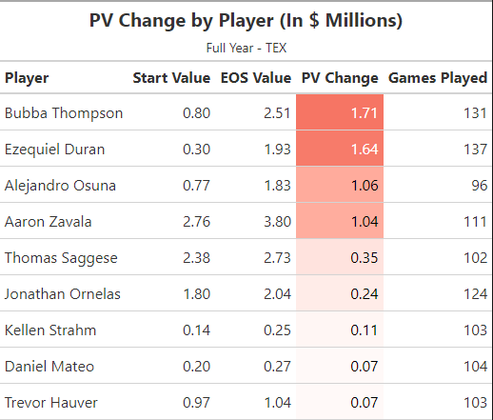
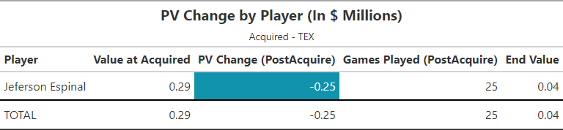
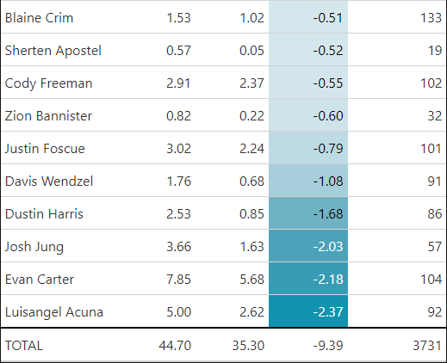
2022 Hitters
Rangers:
Full Year:
#19
Traded:
Acquired:
Drafted (+0.07) –
Griffin Cheney (+0.04), Josh Hatcher (+0.03)
Called Up (-1.92) –
Josh Smith (-1.92)
Late Bloomers (+11.03) –
Yeison Morrobel (+2.13), Maximo Acosta (+1.76), Ian Moller (+1.57)
Released (-14.16) –
Jose Felix (-5.12), Bayron Lora (-3.83)
#22
#17
#29
#19
#6
#30
* MLB Rank

Slide 19
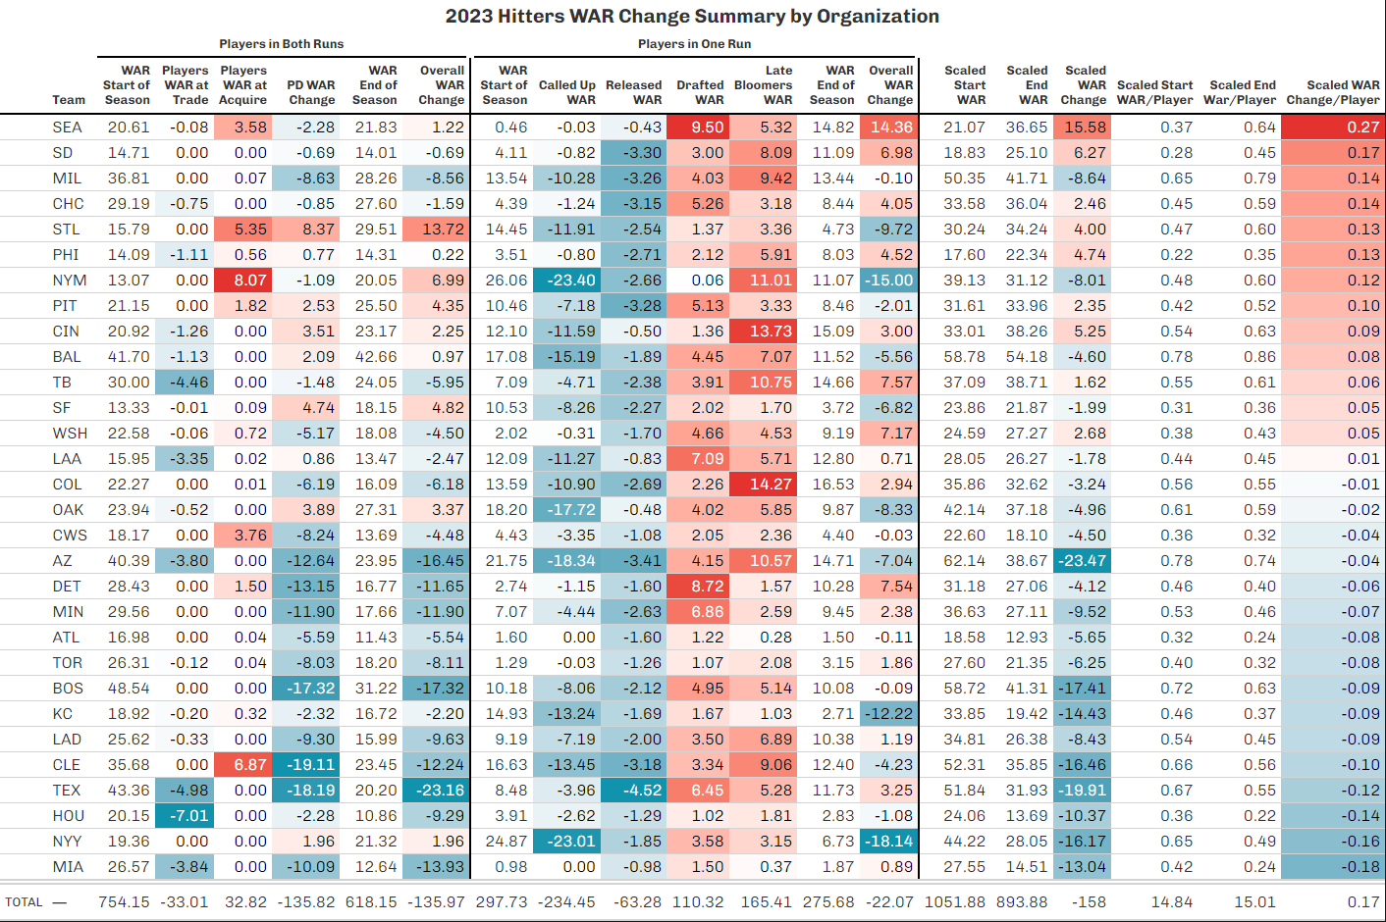
2023 Hitters
#27

Slide 20
2023 Hitters
Top Team: SEA
Biggest positive contributor(s) in both runs –
Acquired WAR Change (+3.58)
Primary cause(s) – Dominic Canzone (+2.17), Ryan Bliss (+1.4)
Biggest positive contributor(s) in one run –
Drafted WAR Change (+9.5)
Primary cause(s) – Colt Emerson (+5.33), Tai Peete (+2.4), Aidan Smith (+1.3)
Bottom Team: MIA
Biggest negative contributor(s) in both runs –
PD WAR Change (-10.09)
Primary cause(s) – Yiddi Cappe (-1.62), Jacob Amaya (-1.33), Peyton Burdick (-1.32)
Biggest negative contributor(s) in one run –
Released WAR Change (-0.98)
There weren’t any categories that dramatically fell off, but they had no category which really improved

Slide 21
2023 Hitters
Extremes:
Most extreme trade change: HOU (-7.01)
Primary cause(s) – Ryan Clifford (-3.58), Drew Gilbert (-1.88), Korey Lee (-1)
Most extreme acquire change: NYM (+8.07)
Primary cause(s) – Ryan Clifford (+3.58), Luisangel Acuna (+2.01), Drew Gilbert (+1.88)
Most extreme PD change: CLE (-19.11)
Primary cause(s) – Jake Fox (-2.38), Joseph Naranjo (-2.27), Angel Genao (-1.96)
Most extreme called up change: NYM (-23.4)
Primary cause(s) – Francisco Alvarez (-12.27), Brett Baty (-8.16), Mark Vientos (-2.97)
Most extreme drafted change: SEA (+9.5)
Most extreme late bloomers change: COL (+14.27)
Primary cause(s) – Adael Amador (+7.89)
Most extreme released change: TEX (-4.52)

Slide 22
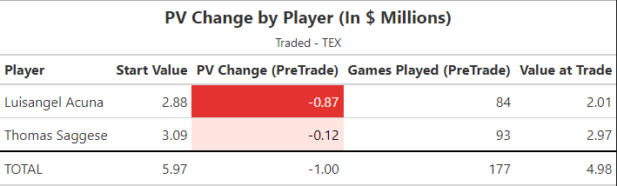
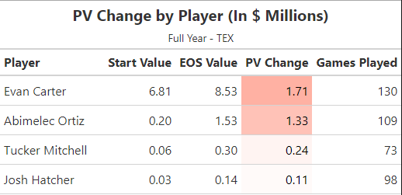
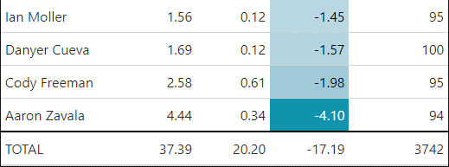
2023 Hitters
Rangers:
Full Year:
#29
Traded:
Acquired: N/A
Drafted (+6.45) –
Wyatt Langford (+5.65), Quincy Scott (+0.8)
Called Up (-3.96) –
Ezequiel Duran (-2.05), Josh Jung (-1.91)
Late Bloomers (+5.28) –
Anthony Gutierrez (+2.38), Chandler Pollard (+0.99), Tommy Specht (+0.6)
Released (-4.52) –
Bubba Thompson (-2.87)
#28
#5
#19
#15
#30

Slide 23
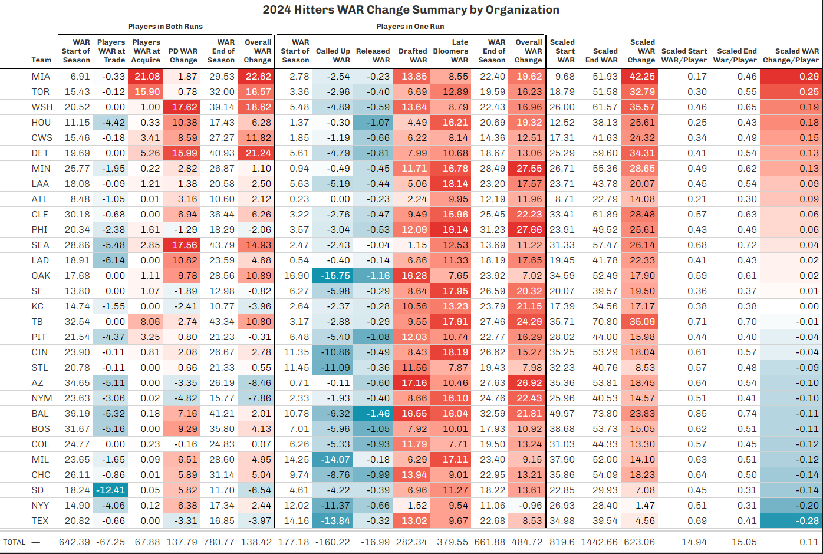
2024 Hitters
#30

Slide 24
2024 Hitters
Top Team: MIA
Biggest positive contributor(s) in both runs –
Acquired WAR Change (+21.08)
Primary cause(s) – Deyvison De Los Santos (+4.11), Jakob Marsee (+3.22), Graham Pauley (+2.79)
Biggest positive contributor(s) in one run –
Drafted WAR Change (+13.85)
Primary cause(s) – Carter Johnson (+3.79) , PJ Morlando (+3.21), Gage Miller (+2.25)
Bottom Team: TEX
Biggest negative contributor(s) in both runs –
PD WAR Change (-3.31)
Primary cause(s) – Jonathan Ornelas (-0.65), Abimelec Ortiz (-0.54), Chandler Pollard (-0.46)
Biggest negative contributor(s) in one run –
Called Up WAR Change (-13.84)
Primary cause(s) – Evan Carter (-7.87), Wyatt Langford (-5.96)

Slide 25
2024 Hitters
Extremes:
Most extreme trade change: SD (-12.41)
Primary cause(s) – Jacob Marsee (-3.22), Graham Pauley (-2.79), Homer Bush (-2.61)
Most extreme acquire change: MIA (+21.08)
Most extreme PD change: WSH (+17.62)
Primary cause(s) – James Wood (+6.92), Trey Lipscomb (+4.34), Dylan Crews (+3.32)
Most extreme called up change: OAK (-15.75)
Primary cause(s) – Zack Gelof (-6.78), Tyler Soderstrom (-5.61)
Most extreme drafted change: AZ (+17.16)
Primary cause(s) – Slade Caldwell (+6.02), Ryan Waldschmidt (+2.77), Ivan Luciano (+2.65)
Most extreme late bloomers change: PHI (+19.14)
Primary cause(s) – Devin Saltiban (+4.42), Kehden Hettiger (+4.24), Starlyn Caba (+2.81)
Most extreme released change: BAL (-1.46)

Slide 26
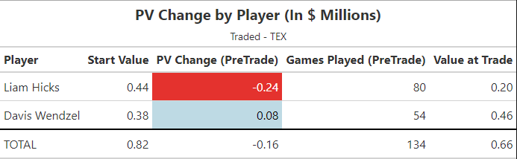
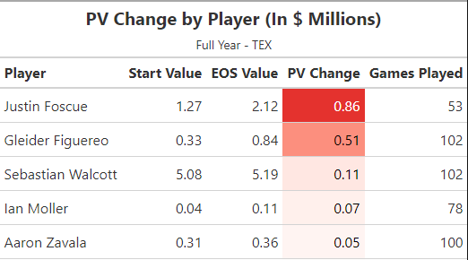
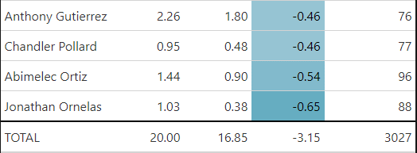
2024 Hitters
Rangers:
Full Year:
#13
Traded:
Acquired: N/A
Drafted (+13.02) –
Malcolm Moore (+4), Devin Fitz-Gerald (+2.56), Josh Springer (+2.16)
Called Up (-13.84) –
Evan Carter (-7.87), Wyatt Langford (-5.96)
Late Bloomers (+9.67) –
Echedry Vargas (+1.96), Maxton Martin (+0.98), Arturo Disla (+0.85)
Released (-0.32) –
Geisel Cepeda (-0.12), Benjamin Blackwell (-0.07), JoJo Blackmon (-0.06)
#28
#7
#3
#22
#9

Slide 27
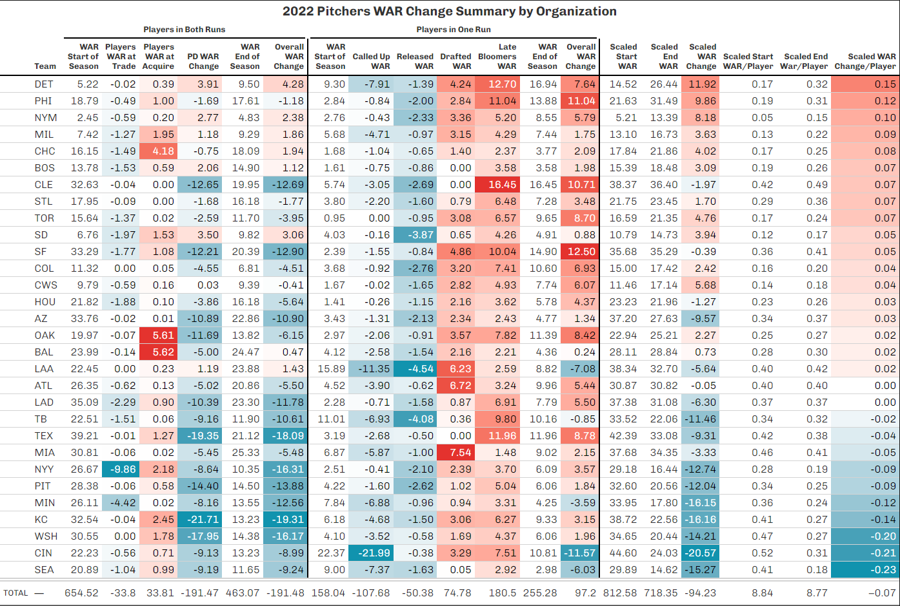
2022 Pitchers
#22

Slide 28
2022 Pitchers
Top Team: DET
Biggest positive contributor(s) in both runs –
PD WAR Change (+3.91)
Primary cause(s) – Wilmer Flores (+1.29), Garrett Hill (+0.86)
Biggest positive contributor(s) in one run –
Late Bloomers WAR Change (+12.7)
Primary cause(s) – Ty Madden (+3.19), Jackson Jobe (+3.1)
Bottom Team: SEA
Biggest negative contributor(s) in both runs –
PD WAR Change (-9.19)
Primary cause(s) – Emerson Hancock (-3.86), Taylor Dollard (-2.43), Isaiah Campbell (-2.08)
Biggest negative contributor(s) in one run –
Called Up WAR Change (-7.37)
Primary cause(s) – George Kirby (-4.77), Matt Brash (-2.42)

Slide 29
2022 Pitchers
Extremes:
Most extreme trade change: NYY (-9.86)
Primary cause(s) – Ken Waldichuk (-3.93), Hayden Wesneski (-3.37)
Most extreme acquire change: BAL (+5.62)/OAK (+5.61)
BAL Primary cause(s) – Cade Povich (+3.08), Chayce McDermott (+1.38)
OAK Primary cause(s) – Ken Waldichuk (+3.93), JP Sears (+0.89)
Most extreme PD change: KC (-21.71)
Primary cause(s) – Asa Lacy (-7.43), Will Klein (-3.36)
Most extreme called up change: CIN (-21.99)
Primary cause(s) – Hunter Greene (-9.47), Nick Lodolo (-6.03), Graham Ashcraft (-2.89)
Most extreme drafted change: MIA (+7.54)
Primary cause(s) – Jacob Miller (+2.01), Karson Milbrandt (+1.51), Joshua White (+1.31)
Most extreme late bloomers change: CLE (+16.45)
Primary cause(s) – Gavin Williams (+4.23), Tanner Bibee (+2.53)
Most extreme released change: LAA (-4.54)

Slide 30
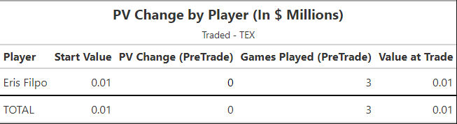
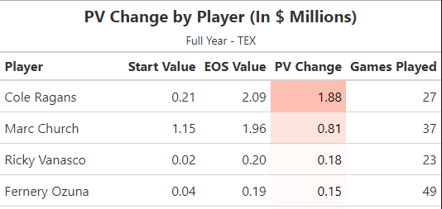
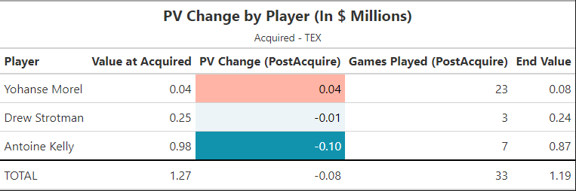
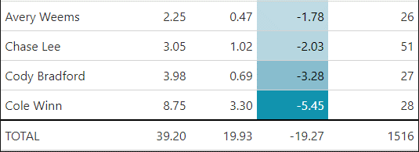
2022 Pitchers
Rangers:
Full Year:
#4
Traded:
Acquired:
Drafted – N/A
Called Up (-2.68) –
Glenn Otto (-2.68)
Late Bloomers (+11.96) –
Jack Leiter (+5.53), Mitch Bratt (+1.84)
Released (-0.5) –
No one of significance
#29
#9
#13
#3
#2

Slide 31
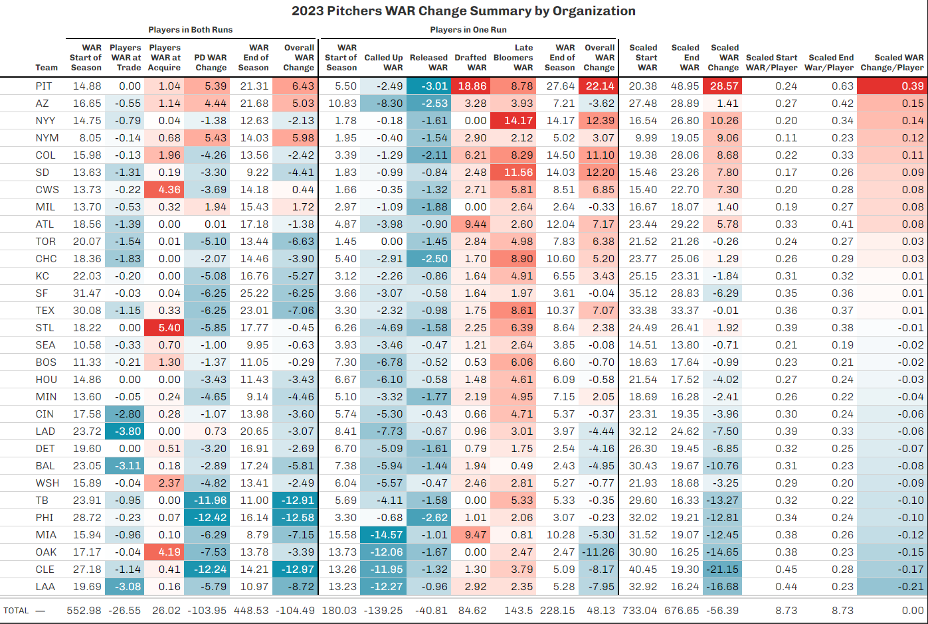
2023 Pitchers
#14

Slide 32
2023 Pitchers
Top Team: PIT
Biggest positive contributor(s) in both runs –
PD WAR Change (+5.39)
Primary cause(s) – Quinn Priester (+2.3), Jared Jones (+2.13), Anthony Solometo (+1.41)
Biggest positive contributor(s) in one run –
Drafted WAR Change (+18.86)
Primary cause(s) – Paul Skenes (+15.57)
Bottom Team: LAA
Biggest negative contributor(s) in both runs –
PD WAR Change (-5.79)
Primary cause(s) – Andrew Peters (-1.08), Eric Torres (-1.06), Luke Murphy (-1.06)
Biggest negative contributor(s) in one run –
Called Up WAR Change (-12.27)
Primary cause(s) – Chase Silseth (-4.51), Ben Joyce (-4), Sam Bachman (-3.1)

Slide 33
2023 Pitchers
Extremes:
Most extreme trade change: LAD (-3.8)
Primary cause(s) – Nicholas Nastrini (-1.68), Nick Robertson (-0.74), Jordan Leasure (-0.6)
Most extreme acquire change: STL (+5.4)
Primary cause(s) – Drew Rom (+2.75), TK Roby (+1.15), Adam Kloffenstein (+1.01)
Most extreme PD change: PHI (-12.42)
Primary cause(s) – Andrew Painter (-5.19), Christian McGowan (-1.52), Griff McGarry (-1.45)
Most extreme called up change: MIA (-14.57)
Primary cause(s) – Eury Perez (-6.6), Max Meyer (-5.25), Andrew Nardi (-2.2)
Most extreme drafted change: PIT (+18.86)
Most extreme late bloomers change: NYY (+14.17)
Primary cause(s) – Drew Thorpe (+4.34), Chase Hampton (+2.63)
Most extreme released change: PIT (-3.01)

Slide 34
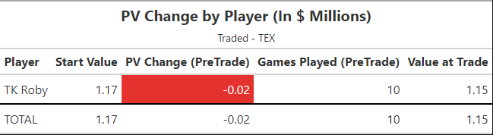
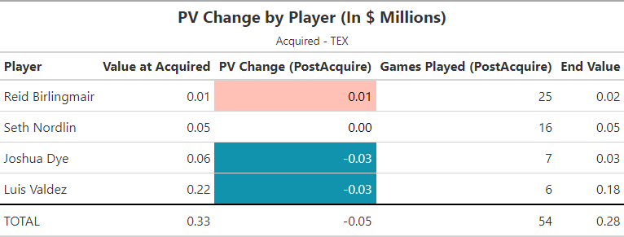
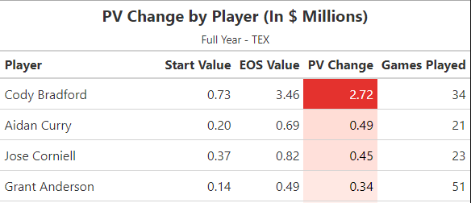
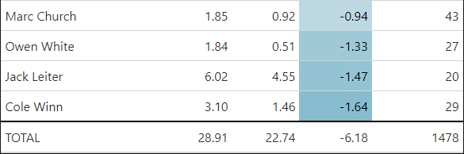
2023 Pitchers
Rangers:
Full Year:
#22
Traded:
Acquired:
Drafted (+1.75) –
Skylar Hales (+0.94), Paul Bonzagni (+0.81)
Called Up (-2.32) –
Cole Ragans (-2.32)
Late Bloomers (+8.61) –
Brock Porter (+3.03), Kumar Rocker (+2.46)
Released (-0.98) –
Ricky Vanasco (-0.23), Bradford Webb (-0.22)
#23
#13
#15
#21
#5
#12

Slide 35
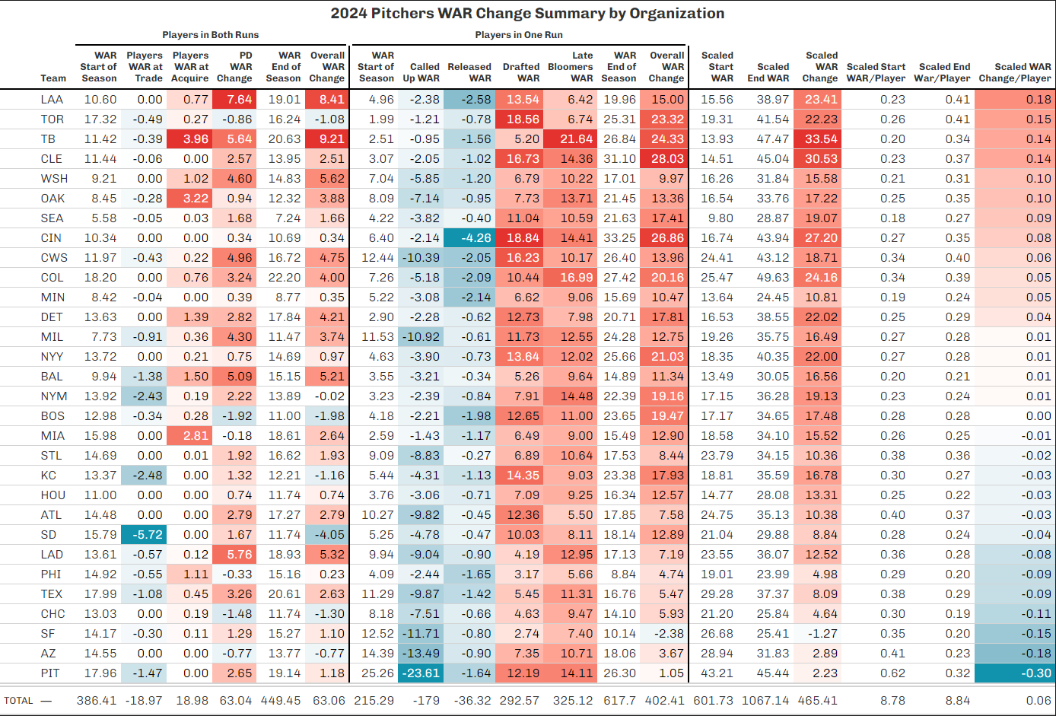
2024 Pitchers
#26

Slide 36
2024 Pitchers
Top Team: LAA
Biggest positive contributor(s) in both runs –
PD WAR Change (+7.64)
Primary cause(s) – Caden Dana (+3.99), Camden Minacci (+1.74), Barrett Kent (+1.32)
Biggest positive contributor(s) in one run –
Drafted WAR Change (+13.54)
Primary cause(s) – Ryan Johnson (+4.85), Chris Cortez (+1.92), Dylan Jordan (+1.66)
Bottom Team: PIT
Biggest negative contributor(s) in both runs –
Traded WAR Change (-1.47)
Primary cause(s) – Patrick Reilly (-1.27)
Biggest negative contributor(s) in one run –
Called Up WAR Change (-23.61)
Primary cause(s) – Paul Skenes (-14.28), Quinn Priester (-4.63), Jared Jones (-2.55)

Slide 37
2024 Pitchers
Extremes:
Most extreme trade change: SD (-5.72)
Primary cause(s) – Dylan Lesko (-2.88), Robby Snelling (-2.62)
Most extreme acquire change: TB (+3.96)
Primary cause(s) – Dylan Lesko (+2.88), Paul Gervase (+0.78)
Most extreme PD change: LAA (+7.64)
Most extreme called up change: PIT (-23.61)
Most extreme drafted change: CIN (+18.84)
Chase Burns (+11.42), Luke Holman (+3.83)
Most extreme late bloomers change: TB (+21.64)
Primary cause(s) – Jackson Baumeister (+2.10), Jeremy Pilon (+1.97), Owen Wild (+1.84)
Most extreme released change: CIN (-4.26)

Slide 38
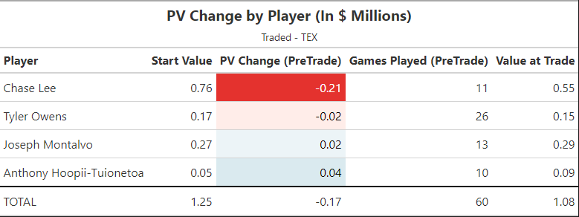
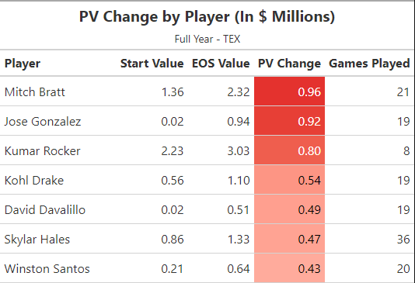
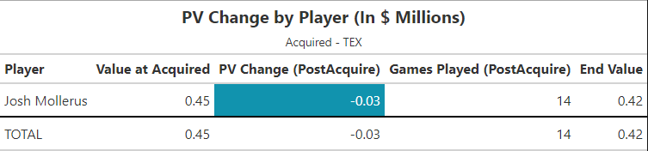
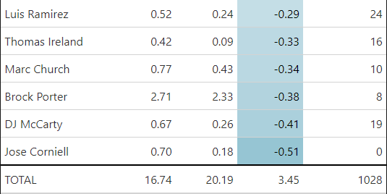
2024 Pitchers
Rangers:
Full Year:
#25
Traded:
Acquired:
Drafted (+5.45) –
Dalton Pence (+1.36), David Hagaman (+1.16), Garrett Horn (+0.8)
Called Up (-9.87) –
Jack Leiter (-3.92), Cody Bradford (-3.17), Cole Winn (-1.26)
Late Bloomers (+11.31) –
Alejandro Rosario (+2.71), Ryan Lobus (+1.06), Case Matter (+0.97)
Released (-1.42) –
Antoine Kelly (-0.51)
#8
#10
#24
#7
#11
#21

Slide 39
Internal WAR Change for Rangers

Slide 40
(7) WAR Ranking by Org
Summary
The following slides contain projected WAR rankings for all 30 clubs from 2022-2024 in each of the following categories:
Player Development (PD + Late Bloomers)
Transactions (Acquisitions – Trades)
Graduated (Called Up)
Drafted
Breakdowns of teams consistently in the Top 10/Bottom 10 of each category are included

Slide 41
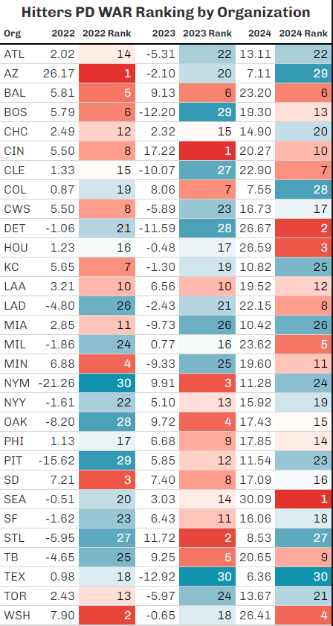
Player Dev (PD + Late Bloomers)
Hitters
Teams in Top 10 every year: BAL, CIN
Teams in Top 10 at least two years: LAA, SD, TB, WSH
Teams in Bottom 10 every year: None
Teams in Bottom 10 at least two years: ATL, AZ, DET, LAD, MIA, NYM, PIT, STL, TEX, TOR

Slide 42
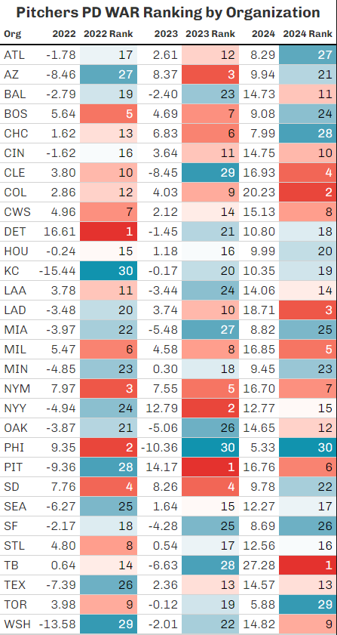
Player Dev (PD + Late Bloomers)
Pitchers
Teams in Top 10 every year: MIL, NYM
Teams in Top 10 at least two years: BOS, CLE, COL, CWS, LAD, PIT, SD
Teams in Bottom 10 every year: MIA
Teams in Bottom 10 at least two years: AZ, KC, MIN, OAK, PHI, SF, WSH

Slide 43
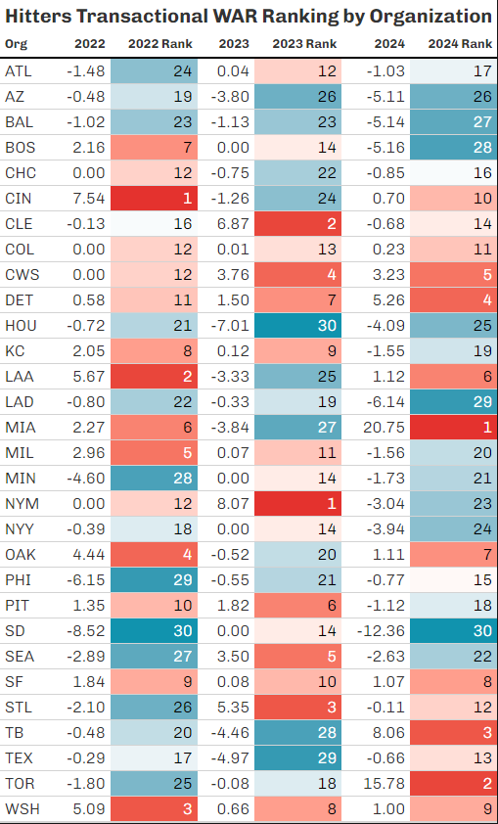
Transactions (Acquisitions – Trades)
Hitters
Teams in Top 10 every year: SF, WSH
Teams in Top 10 at least two years: CIN, CWS, DET, KC, LAA, MIA, OAK, PIT
Teams in Bottom 10 every year: BAL, HOU
Teams in Bottom 10 at least two years: AZ, LAD, MIN, PHI, SD, SEA, TB

Slide 44
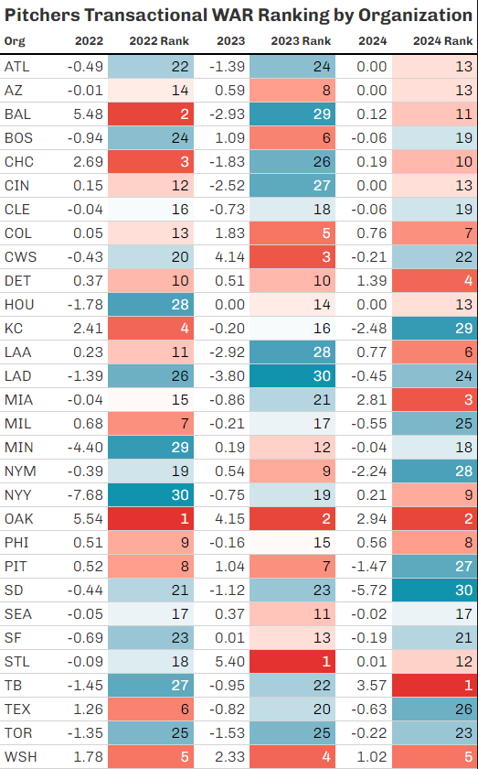
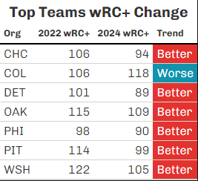
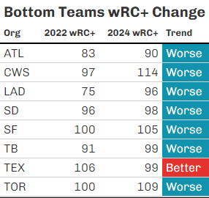
Transactions (Acquisitions – Trades)
Pitchers
Teams in Top 10 every year: DET, OAK, WSH
Teams in Top 10 at least two years: CHC, COL, PHI, PIT
Teams in Bottom 10 every year: LAD, SD, TOR
Teams in Bottom 10 at least two years: ATL, CWS, SF, TB, TEX
*MLB Data only

Slide 45
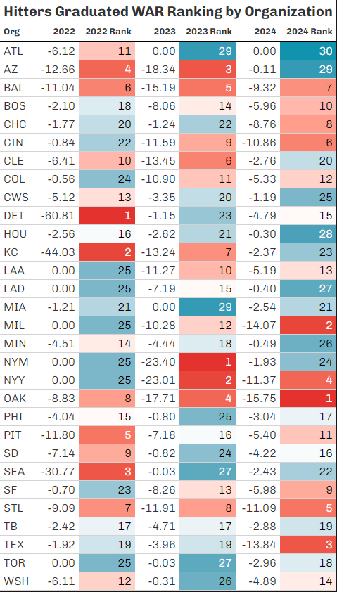
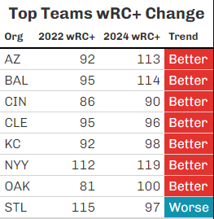
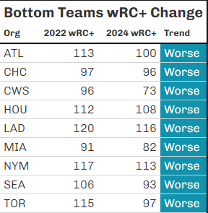
Graduated (Called Up)
Hitters
Teams in Top 10 every year: BAL, OAK, STL
Teams in Top 10 at least two years: AZ, CIN, CLE, KC, NYY
Teams in Bottom 10 every year: MIA
Teams in Bottom 10 at least two years: ATL, CHC, CWS, HOU, LAD, NYM, SEA, TOR
*MLB Data only

Slide 46
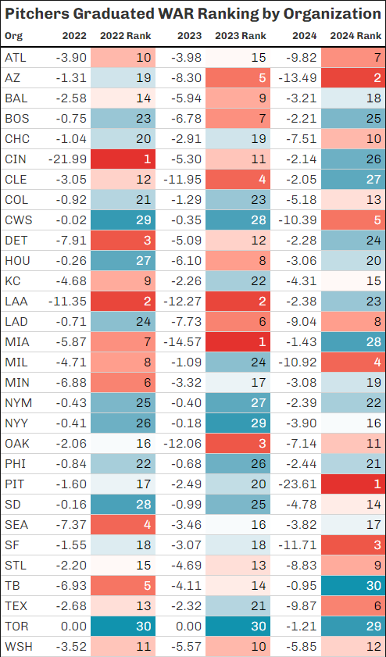
Graduated (Called Up)
Pitchers
Teams in Top 10 every year: None
Teams in Top 10 at least two years: ATL, AZ, LAA, LAD, MIA, MIL
Teams in Bottom 10 every year: NYM, PHI, TOR
Teams in Bottom 10 at least two years: BOS, COL, CWS, HOU, NYY, SD

Slide 47
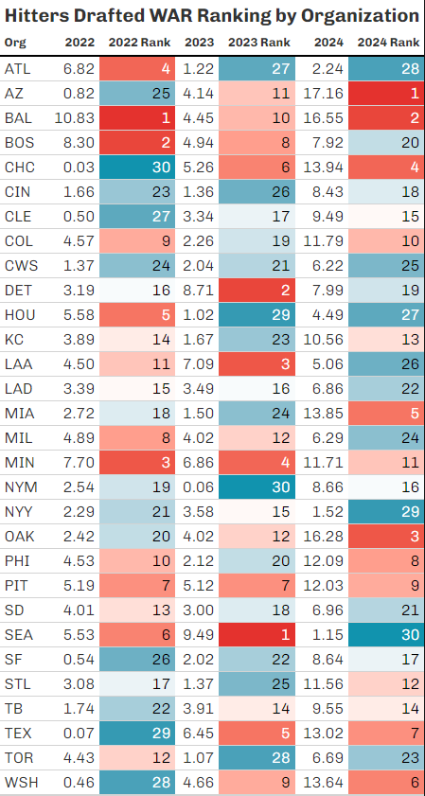
Drafted
Hitters
Teams in Top 10 every year: BAL, PIT
Teams in Top 10 at least two years: BOS, CHC, COL, MIN, PHI, SEA, TEX, WSH
Teams in Bottom 10 every year: CWS
Teams in Bottom 10 at least two years: ATL, CIN, HOU, NYY, SF, TOR

Slide 48
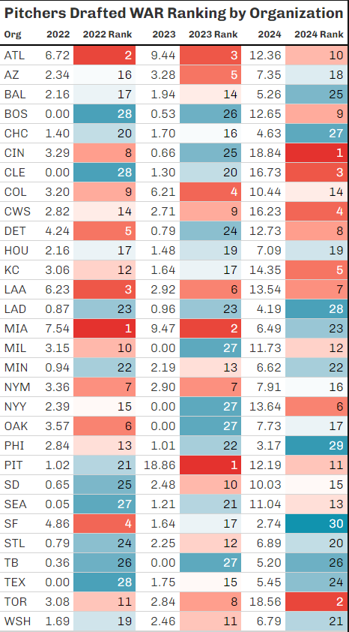
Drafted
Pitchers
Teams in Top 10 every year: ATL, LAA
Teams in Top 10 at least two years: CIN, COL, CWS, DET, MIA, NYM, TOR
Teams in Bottom 10 every year: LAD, TB
Teams in Bottom 10 at least two years: BOS, CHC, CLE, MIN, PHI, SEA, STL, TEX

Slide 49
Which teams excel in one area for both?
PD: SD
Transactions: WSH, DET, OAK, PIT
Graduated: AZ
Drafted: COL
Which teams struggle in one area for both?
PD: AZ, MIA
Transactions: LAD, SD, TB
Graduated: CWS, HOU, NYM, TOR
Drafted: None

Slide 50
Good Hitting, Bad Pitching
PD: WSH
Transactions: SF, CWS
Graduated: NYY
Drafted: BOS, CHC, MIN, PHI, SEA, TEX
Good Pitching, Bad Hitting
PD: LAD, NYM, PIT
Transactions: PHI
Graduated: MIA, ATL, LAD
Drafted: CWS, ATL, CIN, TOR

Slide 51
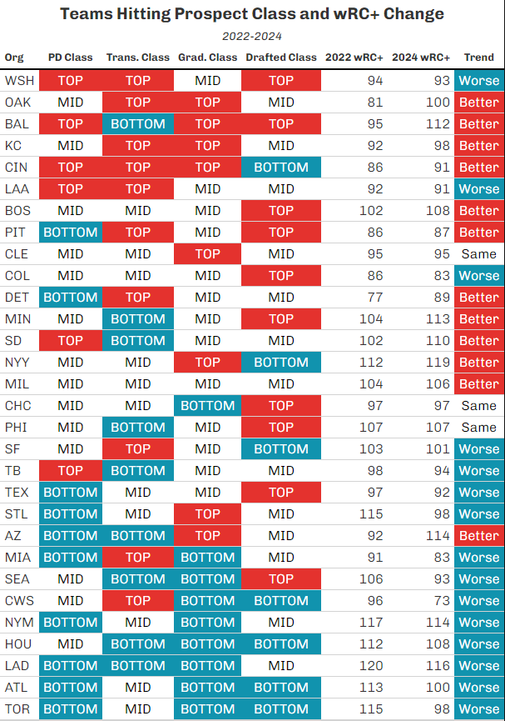
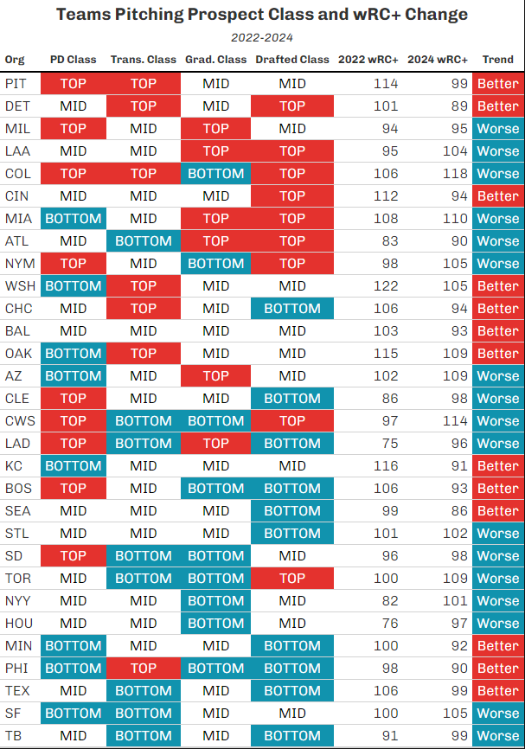
(8) Does better all-around prospect management lead to big league success?
For hitters, YES!
For pitchers, it’s
more random

Slide 52
General Takeaways
Actionable Takeaways
Hitting: Teams that consistently graduate good hitting prospects to the big leagues have improved offensively at the big-league level, and vice versa
Pitching: Teams that consistently trade for high value pitching prospects have improved their ability to limit damage at the big-league level, and vice versa
Overall: Great all-around management of hitting prospects is a recipe for offensive success at the big-league level

Slide 53
Questions?

